Slide 1
Promoting Unheard Voices in Higher Education Settings Through the Introduction of Small, Student Centred Research Communities
Michael Pomerantz, PhD
m.pomerantz@sheffield.ac.uk

Slide 2
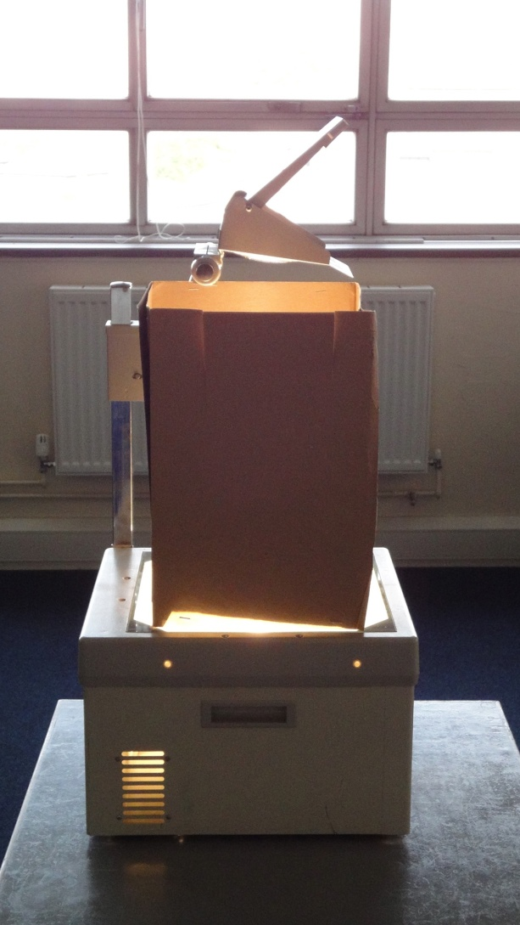
Overhead projector

Slide 3

Projected shadows

Slide 4
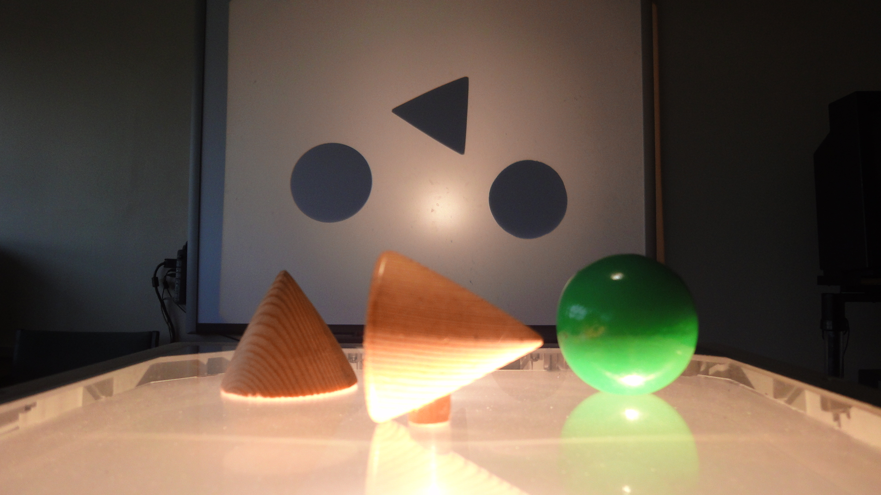
New perspective

